Slide 1
Comparing Deep Composers for Eurovision AI Song Contest
By Otto Mättas, Thijs Hendrickx and Thijs Ratsma
Notes:
Good news everyone! There’s more Eurovision music out there than ever before and the pace of creating it is rapidly growing. So we wanted to know what’s the best way to contribute in this wholesome effort.

Slide 2
Index
Eurovision AI Song Contest
Research goals
musAIc
Commercial products
Folk RNN
Results
Discussion
Notes:
A brief overview of the upcoming slides. And there is a lot so please, be gentle and ask afterwards if something was unclear.
We will be talking about:
The premise of the project;
Research we did and are doing;
Some methods we used and are using;
Finally, we will spend some time on the results;

Slide 3
Eurovision AI Song Contest
VPRO
What makes a song fit for Eurovision?
Dataset of ~200 MIDI files
Sharing is caring
Notes:
VPRO, a Dutch broadcasting organisation has set up a challenge - can artificial intelligence help compose a song that is just as successful as last year’s hit? Or rather, how far are we able to take it as a community?
Most importantly, the challenge focuses on sharing the experience, open sourcing the work put in and having a platform for people to jump from, in terms of AI and music generation. They provided us with a dataset from previous Eurovision competitions for us to model on.
Also, they have a core project team generating their own song - some people are from in-house and some come from different universities while we are also collaborating with them.
So we naturally thought - which way should we continue in order to contribute best and decided to look into comparing some AI methods for music modelling and also music generation.

Slide 4
Research goals
How do musAIc, commercial composers and Folk-RNN compare?
What parameters produce the “best” result?
Notes:
We chose our main focus to be on comparing different solutions out there already. We chose to compare three sides of the story:
musAIc which is the internal tool the VPRO team is using; pronunciation still under discussion;
Commercial composers which are the tools available for general public and most likely the first hits when you search for AI music generation online;
Folk rnn which is the tool covered in class and also a famous sample of music generation from already 5 years ago;
Secondly, we spent our efforts on finding what makes for a good result and what does the opposite. How to tune our models essentially?

Slide 5
musAIc
Created by member of AI Contest team
Geared towards production of music
Advanced tools and parameter tweaking
Still in development
Dependant
Notes:
The first deep composing tool that was considered by us was musAIc, internally created by another member from the VPRO AI Contest team.
musAIc is special in the sense that it is geared towards not only generation of samples, but also further producing that sample into music.
However, this tool is still in development and as such, no documentation is valid and available.
Furthermore, training the network is done via use of a server that even the creator has limited access to, meaning that we are even more dependant on them to create create a model.

Slide 6
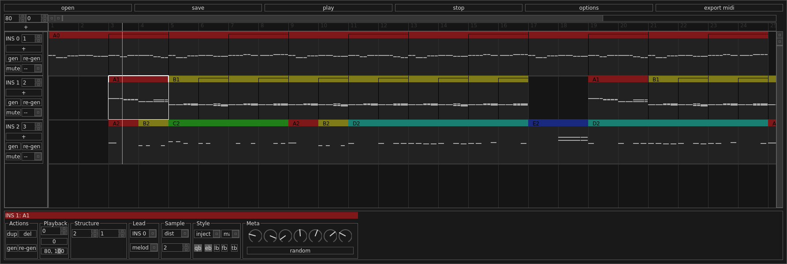
Notes:
Here you can see the GUI for the musAIc.

Slide 7
Commercial products
AWS DeepComposer
AWS Sagemaker
Google Magenta
Musenet
Azure
Notes:
So, what are the tools out there meant for users rather than researchers? We looked at many and here are some takeaways.
It is the easiest to generate your first piece of music with Musenet while Sagemaker gives you the most power and freedom.
It was becoming clear, though that the market gravitates towards two categories - fun tools others have built for research and fully-capable general purpose AI/ML studios with a lot of customization options.
We generated many models and tried to reach the end goal of having music but due to limitations of the tool and our experience with the full landscape (for studios), we did not get to usable output yet. So what we did do…

Slide 8
Folk RNN
Introduced during prior lectures
Meant as composing tool, not producer
Originally for folk songs
Test of adaptability
Notes:
We dove into Folk RNN which was also covered in our course.
Essentially, it’s a command line tool meant to help with composing but not meant for producing a full song.
The method was originally developed using Irish folk tunes and has been used since to generate many fine Irish tunes which have been taken by artists and made into songs you can for example find on Youtube.
As it has been available for five years, you can find a community and experience out there which really helps in understanding the tool and using it for our Eurovision song generation.
On the other hand, this also brings the question of - is it still relevant and up to date? Well, not really - it hasn’t seen updates since it was released. The author supports the documentation but has clearly dedicated their efforts towards something else.
Anyway, it still comes with great customisation options and a relatively good documentation.

Slide 9
Results - Iteration 1
Same parameters used by the authors in their paper
Samples generated had a huge amount of overfitting
Scaling of training parameters to our dataset size
Notes:
When we first got started with Folk-RNN we used the same parameters the authors used for their paper.
We realised soon after that this would not work, as we had a much smaller dataset.

Slide 10
Results - Iteration 2
Scaled to our dataset size
Neurons per layer
Batch size
Validation rate
Same learning rate
Worse than expected
Notes:
So for iteration 2 we scaled the parameters to match our dataset size.
While a lot better, this still resulted in worse than expected samples.

Slide 11
Results - Iteration 3
Learning longer and more consistent
Epochs up
Decay start and rate up
Learning rate up
Batch size up
Better
Notes:
Here we started changing the neural network hyperparameters.
We took many more iterations stemming from this one until we were able to produce music.

Slide 12


Generated samples
Notes:
Now, a small exercise. You can help our research along by taking part in a small classroom-study.

Slide 13
Discussion
Very small dataset
musAIc development
Consumer market is wide but not perfect
Folk RNN can be used for composing inspiration for the VPRO team
Notes:
So what limitations have we encountered?
The dataset of 200 songs is very small and poses threat on the model creation. Just not enough data to make good generalisations
musAIc looks like a great tool but as with many such great solo projects - there is no documentation and is in “continuous development” so it might never be released
Consumer market has potentially all the tools you would ever need for proper song creation but they are all scattered so you need to make your own decisions and research a lot - there is hope as AWS DeepComposer will be released in coming months.
In the current findings, we see that Folk RNN can be of use in terms of the complexity of the ecosystem and ease of use.

Slide 14
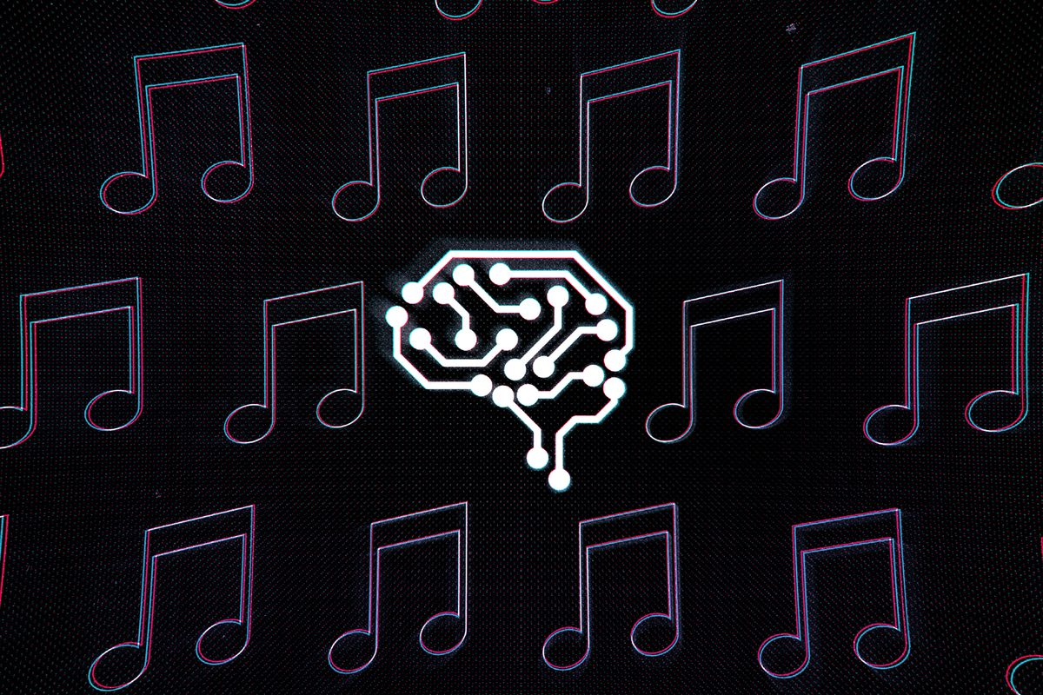
Notes:
Thank you for now and if you have any further questions - please ask me or Thijs or Thijs later!

